Slide 1

[Samsung PRISM Monthly Connect]
[ Explore & Implement Image Augmentation Options]
Worklet ID: RSG32CU
Team
College Professor(s): Mrs Puneet Kaur – puneet.e13341@cumail.in
Mr Vishal Prasad – vishal.e14181@cumail.in
Students:
Matcha Pavan Kumar – 20bcs6072@cuchd.in
Priyangshu Sarkar – 20bcs6047@cuchd.in
Arpit Mahajan – 21bcg1115@cuchd.in
Department: AIT - CSE
Date: 27 March 2023

Slide 2
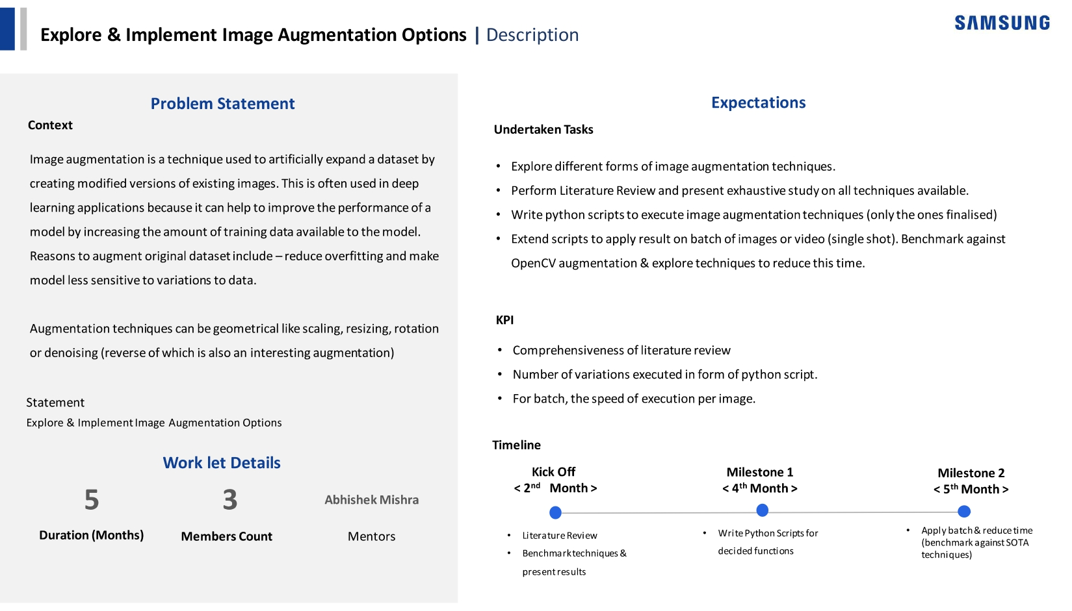
Notes:
-

Slide 3
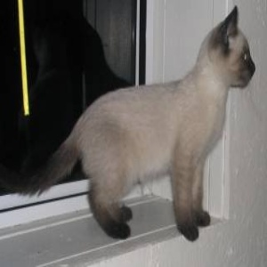
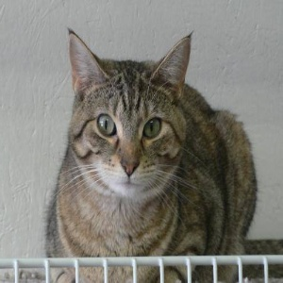
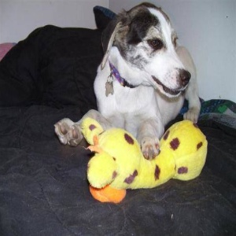
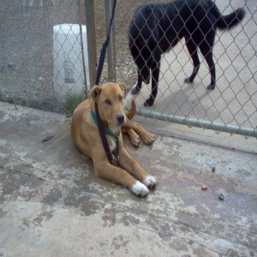
Research work
Our Approach on Image Augmentation Techniques:
Major Goals:
Reducing overfitting of the model.
Improving the performance of the model.
Making the model invariant to various transformations.
Cats
Experimental setup:
Dataset: Cats vs Dogs
Total size: 25000
Training size: 3000 (1500 of Cats, 1500 of Dog)
Test size: 22000
Note: To test the impact of the augmentation techniques, we will take
some random samples from the test dataset and apply the same technique
and we will ask the model to predicit.
Dogs

Slide 4


Research work
Our Approach on Image Augmentation Techniques:
Priorities:
Making the model invariant to rotational transformations.
Making the model invariant to translation or shift operations.
Making the model invariant to zoom/ scaling transformations.
Making the model invariant to various distortions or making the model robust to small transformations.
In a nutshell, our first priority is to make the model invariant to all geometrical transformations.
If this is a Cat
Then these are also Cat

Slide 5
Research work
Our Approach on Image Augmentation Techniques:
How to teach the model that all those images are same?
Method 1: Provide all possible transformations to the model (This is not a practical approach. The space and time complexities are not acceptable).
Method 2: Treating this problem as a search problem and find various sequence of augmentation techniques and choose the sequence which impact the model most. (This is a good approach but finding a right sequence of augmentations is difficult because there are infinite number of variations possible).
Method 3 (Our approach):
Step 1 (Categorization of Dataset): In this step, based on the domain we will categorize which type features we want to preserve. Based on this, we will narrow down in certain set of augmentations.
Step 2 (Applying of the Techniques): Based on the size of the dataset we have, we will be applying the techniques on each image. If we have good amount data to start with, then, we will only apply augmentations to certain images and only certain techniques.

Slide 6
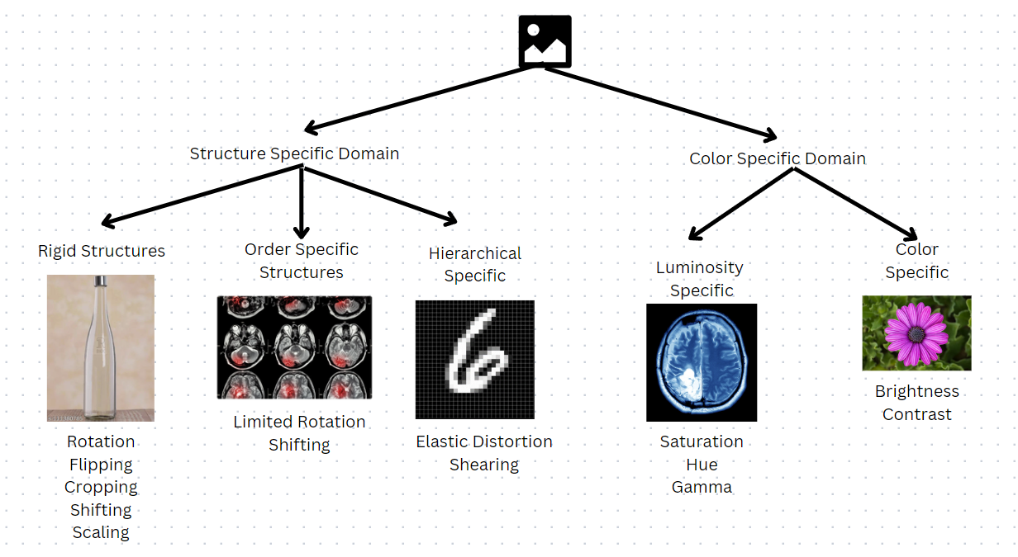
Research work
Our Approach on Image Augmentation Techniques:

Slide 7
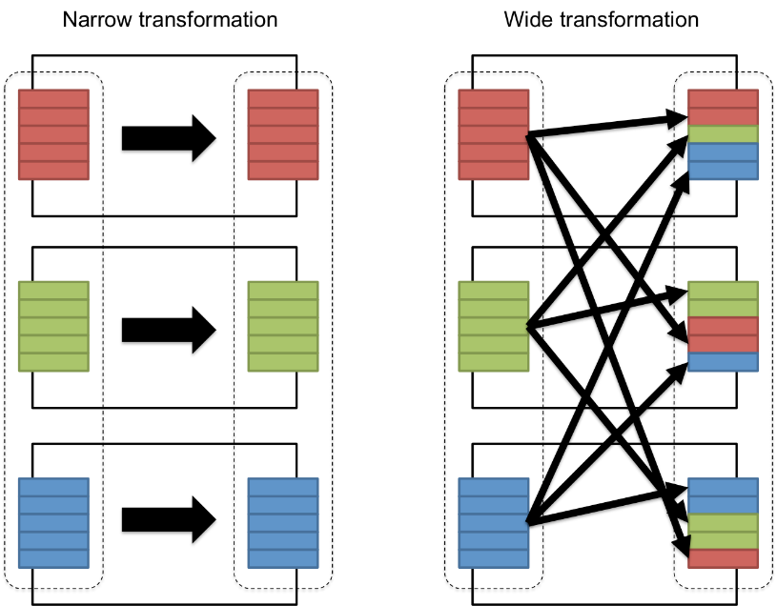
Research work
Our Approach on Image Augmentation Techniques:
But that is not the full picture
Whenever, we think regarding model performance, we will mostly focus of the model architecture, amount of data, number of epochs, etc. But, one important thing that we are missing out is how we are feeding the data to the model.
In general, we will randomize the data. We will shuffle the ordering of
data. It is known that shuffling the data avoid overfitting of the model.
But in our approach, we are comparing how humans perceive the world
and how the computer will perceive the world.

Slide 8
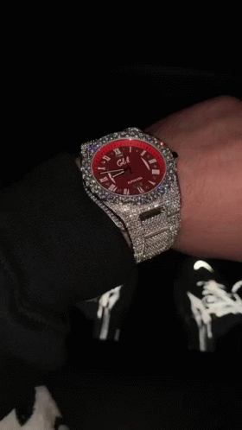
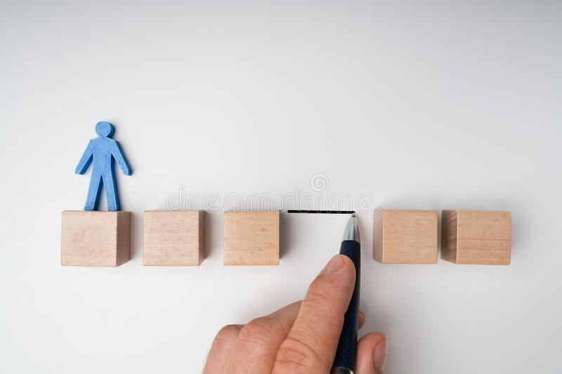
Research work
Our Approach on Image Augmentation Techniques:
Human Vision:
Humans perceive the world in sequential manner. For example, you show me a
watch, I will not look at just one frame rather I will look at it for some like
say 1 or 2 seconds. In general, we know that humans will take nearly 24 – 30
frames per seconds (that’s why movies are all framed at this rate). That means
if I look at the watch for 2 seconds, I’m generating data of approximately 48
images and each image have minor changes like different orientation, change in
shadows, etc. So, what we are doing here is sequential learning. We are
comparing what we have already learned with what new to learn.

Slide 9
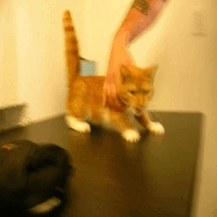
Research work
Our Approach on Image Augmentation Techniques:
Applying the same in Computer Vision:
But to train a model we have images. But there images are static and limited in
information. Just by showing the image to the model and if we ask it is learn the
model will memorize (overfit) to it rather than observing the features of the image.
So, to replicate the sequential processing as humans in the computer, we have
generated the transformation such that these will induce motion into the image.
And also during training, we will give the data sequentially as specified in the
Above gif. We will batch all the images generated from the single image and feed it to the model. And we do this alternatively for cats and dogs. Due to that the model will develop discriminative capabilities.

Slide 10
Research work
Our Approach on Image Augmentation Techniques:
Augmentation techniques applied include:
Flipping
Laplacian Edge detection
Rotation with 45 degree interval and 45 plus stacking
Rotation with quad centers at 45 degree interval
Horizontal Shifting from -100 to 100 with 50 pixel stacking and motion blur
Vertical Shifting from -100 to 100 with 50 pixel stacking and motion blur
Note: To increase the robustness of the model to pixel to pixel variations, we have applied blur filter before passing the image into Max Pooling layer. And as we are feeding the images sequentially, there is a high chance of overfitting, so, to mitigate that, we have performed heavy regularization using dropout layer with almost dropping 40 to 50 % neurons.

Slide 11
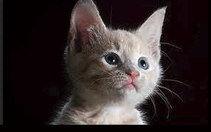
Research work
Our Approach on Image Augmentation Techniques:
Inducing lighting changes:
Lighting condition plays a major role for the model in the edge detection
so, it is important to make sure that the model is invariant to various
lightening conditions. By combining major lighting changes and inducing
motion, we can get the effect of training the model on a video (sequential)
rather than on static images.

Slide 12
Research work
Our Approach on Image Augmentation Techniques:
Developing techniques to check the invariance of the model
As mentioned in the Preliminary discussion, it is important to get the impact of applying an augmentation in real-time due to following reasons:
Data generation time and memory writing.
2) Model training time and wastage of computational resources.
3) Wastage of human resources.

Slide 13
Research work
Our Approach on Image Augmentation Techniques:
Developing techniques to check the invariance of the model
So, to get the amount of invariant the model is to certain variations, we developed a method:
Step 1: Make a basic model and train it on the original data.
Step 2: After training the model, select some random number of images from the original data. These are the images which the model can predict perfectly.
Step 3: Generate the convolution map those images. This map contains the information of the features using which the model is classifying the above image.
Step 4: Now, perform the augmentation technique on which you want to test on those random sample and generate the convolution map of those images. After that, apply the same augmentation technique on the convolution map of the original samples.
Step 5: The amount of overlapping between the original convolutions and augmented convolutions will give us the invariant score of the model for that particular augmentation technique.

Slide 14


Research work
Our Approach on Image Augmentation Techniques:
Developing techniques to check the invariance of the model
Step 1:
Training
Model

Slide 15
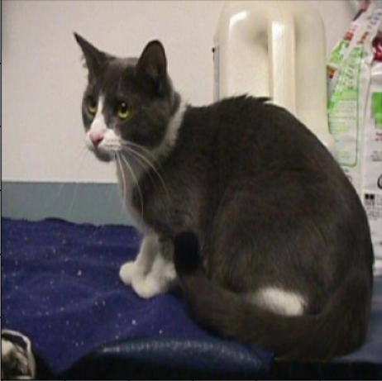
Research work
Our Approach on Image Augmentation Techniques:
Developing techniques to check the invariance of the model
Step 2:
“CAT”
Image from Training dataset
Model

Slide 16
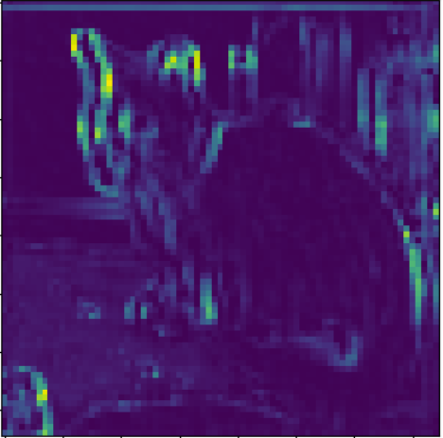

Research work
Our Approach on Image Augmentation Techniques:
Developing techniques to check the invariance of the model
Step 3:
“CAT”
Original features
Features learned by the model
Image from Training dataset
Model

Slide 17
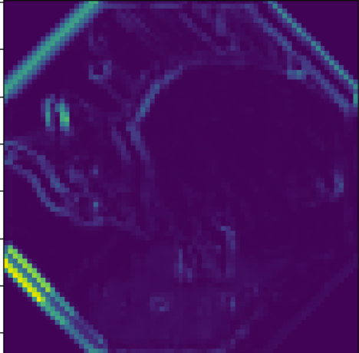
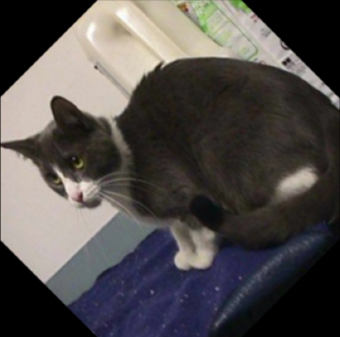
Research work
Our Approach on Image Augmentation Techniques:
Developing techniques to check the invariance of the model
Step 4:
“CAT”
Augmented Features
Features detected by the model
45 degree Augmented
Image
Model

Slide 18
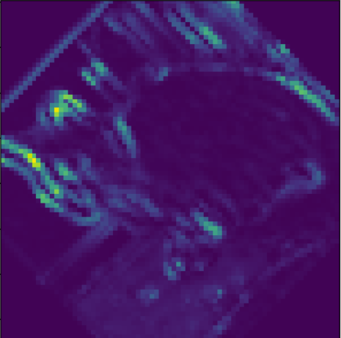
Research work
Our Approach on Image Augmentation Techniques:
Developing techniques to check the invariance of the model
Step 4:
Augmentation
Original Sample
Original Features
Here, we are applying same augmentation on the original feature map

Slide 19
Research work
Our Approach on Image Augmentation Techniques:
Developing techniques to check the invariance of the model
Step 5:
Amount of
overlapping
“Invariance Score”
Original Features
Features detected on Augmented Image

Slide 20
Research work
Literature Survey:
Year and Citation | Simard, Patrice Y., David Steinkraus, and John C. Platt. "Best practices for convolutional neural networks applied to visual document analysis." Icdar. Vol. 3. No. (2003).
Article/Author | PY Simard
Tools/Software | CNN, deep learning
Technique | Describes a set of concrete best practices that document analysis researchers can use to get good results with neural networks. The most important practice is getting a training set as large as possible: we expand the training set by adding a new form of distorted data.
Source | ResearchGate
Year and Citation | Cubuk, Ekin D., Barret Zoph, Dandelion Mane, Vijay Vasudevan, and Quoc V. Le. "Autoaugment: Learning augmentation strategies from data.", pp. 113-123. (2019).
Article/Author | ED Cubuk
Tools/Software | TensorFlow, Keras
Technique | Improving the accuracy of modern image classifiers. However, current data augmentation implementations are manually designed.
Source | Google Scholar

Slide 21
Research work
Year and Citation | Zhang, Richard. "Making convolutional networks shift-invariant again." International conference on machine learning. PMLR, (2019).
Article/Author | R Zhang
Tools/Software | Neural network, ImageNet classification
Technique | It can be incorporated across layer types and applications, such as image classification and conditional image generation. And we also observe that boost accuracy in imageNet classification.
Source | Google scholar
Year and Citation | Cireşan, Dan C., et al. "High-performance neural networks for visual object classification." arXiv preprint arXiv:1102.0183 (2011).
Article/Author | Dan C. Ciresan
Tools/Software | OpenCV, Keras, CNN
Technique | Fully parameterizable GPU implementation of Convolutional Neural Network variants. Our feature extractors are neither carefully designed nor pre-wired, but rather learned in a supervised way.
Source | Springer

Slide 22
Work-let Name: Explore & Implement Image Augmentation Options
Worklet Details
Worklet ID: RSG32CU
College Name: Chandigarh University
Thorough Literature review is done
Evaluation of performance of various model architectures on various augmentation techniques is done.
The number of augmentation techniques are unlimited choosing right sequence is a challenge.
During experimentation, the time taken to train a model is concerning.
Making model robust to small variations in pixels is quite a challenge.
KPIs achieved till now
Any Challenges/ Issues faced
Next Steps
More analysis on combine effect on geometrical augmentation and colour augmentations.
Exploring other types of data generation through methods like GAN, Autoencoders.
More research on how to make the model invariant to transformations through sequential learning mechanism.
More research on using less number of augmentations to get impact of more.
We started with a accuracy of 74% on 4000 test images and now we are able to achieve accuracy of 80 % on 18000 test images.
Model trained in sequential manner is 30% more robust to various transformations rather than the non-sequential or shuffled models.
Key Achievements/ Outcome till now
Date: 27-03-2023

Slide 23
References
[1] Inoue, Hiroshi. "Data augmentation by pairing samples for images classification." arXiv preprint arXiv:1801.02929 (2018).
[2] Chapelle, Olivier, and Bernhard Schölkopf. "Incorporating invariances in non-linear support vector machines." Advances in neural information processing systems 14 (2001).
[3] Cireşan, Dan C., Ueli Meier, Jonathan Masci, Luca M. Gambardella, and Jürgen Schmidhuber. "High-performance neural networks for visual object classification." arXiv preprint arXiv:1102.0183 (2011)
[4] Marini N, Otalora S, Wodzinski M, Tomassini S, Dragoni AF, MarchandMaillet S, Morales JP, Duran-Lopez L, Vatrano S, Müller H, Atzori M. Datadriven color augmentation for H&E stained images in computational pathology. Journal of Pathology Informatics. 2023 Jan 3:100183.

Slide 24
Thank you

